Slide 1
Entity-Relationship Model
Lecture # 2
Imran Siddiqi
imran.siddiqi@mcs.edu.pk
Computer Science Department
College of Telecommunication Engineering
National University of Sciences and Technology

Slide 2

Data Models
Recap
A collection of tools for describing:
  Data
  Data relationships
  Data semantics
  Data constraints
Entity-Relationship model
Relational model

Slide 3
ER Model
Recap
A high level data model based on perception of a real world comprising a collection of entities and of relationships among these entities
Relational Model
A lower level data model that uses a collection of tables to represent both data and relationships among those data

Slide 4
ER and Relational Models
Recap
Both are Conceptual data models
Designers formulate the database schema by first modeling the data at a high level, using the ER model and then translate it into the relational model

Slide 5
ER Model
A popular data model – useful to database designers
  Graphical representation of miniworld
ER design is translated to Relational model
Elements of ER Model
  Entities
  Entity Sets
  Attributes
  Relationships

Slide 6
Entity & Entity Sets
Entity
  An entity is a thing or object in the real world that is distinguishable from other objects.
  E.g. A person, a car, a bank account
Entities have attributes
  E.g. People have names, addresses etc.
Entity Set
  An entity set is a set of entities of the same type that share the same properties.
  E.g. set of customers in a bank, set of all students in a college etc.

Slide 7




Entity & Entity Sets
Examples of entities:
  Person: EMPLOYEE, STUDENT, PATIENT
  Place: STORE, WAREHOUSE
  Object: MACHINE, PRODUCT, CAR
  Event: SALE,REGISTRATION, RENEWAL
  Concept: ACCOUNT, COURSE
Guidelines for naming and defining entity types:
  An entity type name is a singular noun
  An entity type should be descriptive and specific
  An entity name should be concise
Entity Set – Represented by a rectangle
Department
Student

Slide 8
Attributes
An entity is represented by a set of attributes, that is descriptive properties possessed by all members of an entity set
  E.g. name, address, weight, height are properties of a Person entity.
Guidelines for naming attributes:
  An attribute name is a noun
  An attribute name should be unique
  To make an attribute name unique and clear, each attribute name should follow a standard format
  Similar attributes of different entity types should use similar but distinguishing names

Slide 9
Attributes
Properties of entities in entity set
  Like fields in a struct
  Like columns in a table/spreadsheet
  Like data members in an object
Domain – the set of permitted values for each attribute
  E.g Name can take can be text strings of a certain length
Represented by Ovals
ID
Name
Student

Slide 10
Attributes: Types
Simple & Composite Attributes
  Simple attributes contain a single value
EmpNo
Employee
Name
ID

Slide 11
Attributes: Types
Simple & Composite Attributes
  Composite attributes can be divided into sub-parts
EmpNo
FirstName
Employee
Name
MidName
ID
LastName

Slide 12
Attributes: Types
Single-Valued & Multi-Valued attributes
  Multi-Valued attributes contain more than one value
Phone
Employee
Email

Slide 13
Attributes: Types
Derived attributes
  Computed from other attributes
Can be derived from DoB
Age
Employee
Bonus
Can be derived from salary

Slide 14
Attributes: Types
Key Attributes
  Uniquely identify an entity
EmpNo
Employee
ERD
Name
EmpNo
Name
. . .
123456
John Wong
. . .
Tabular
456789
Mary Cheung
. . .
146777
John Wong
. . .

Slide 15
Attributes: Types
Composite key
  Name or Address alone cannot uniquely identify an employee, but together they can!
Address
Employee
Name

Slide 16
Attribute: Types
An entity can have more than one candidate keys
One of them is selected as key – the primary key
In many cases, a key is artificially introduced (e.g., EmpNo) to make applications more efficient
Unique
EmpNo
Primary Key
Employee
Name
SS_Number
Unique

Slide 17



Relationship
A relationship is an association among several entities
  Relationship name is an active or a passive verb.
Relationship name: writes
Author
Book
An author writes a book
A book can be written by an author

Slide 18
Relationship
Given a customer and an account, the relationship deposits between them indicates that the customer deposits money into the account
Students enroll in courses
Hayes deposits A-102
customer entity relationship account entity
Students
Enroll
Courses
Represented by a diamond

Slide 19
Relationships
Students enroll in courses
Courses are held in rooms
Students
Enroll
Courses
ID
Name
held
Rooms

Slide 20
Relationship Sets
A relationship set is a set of relationships of the same type
Mathematically, a relationship set is a relation among n ≥ 2 entity sets. If E1,E2,…En are entity sets then a relationship set R is a subset of:
where (e₁, e₂, …, e_{n}) is a relationship
  Example:
  (Hayes, A-102) ∈ Deposits
{(e1, e2, … en) | e1 ∈ E1, e2 ∈ E2, …, en ∈ En}

Slide 21
Representation of a Relationship
Deposits
CustomerNo
AccountNo
A123456
A-101
B456789
A-201
B456789
A-302
A123456
A-101
B456789
A-201
A-302

Slide 22
Relationship Sets
Relationships can have descriptive attributes
For instance, the deposits relationship set between entity sets customer and account may have the attribute access-date
Can we add multiple access dates?
CustomerNo
AccountNo
AccessDate
A123456
A-101
25 Aug 2010
B456789
A-201
3 June 2009
B456789
A-302
2 Mar 2010
Note: A relationship instance in a relationship set must be uniquely identifiable from its participating entities without using the descriptive attributes

Slide 23
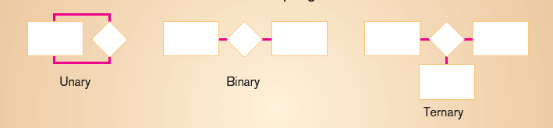
Degree of Relationships
Degree: number of entity types that participate in a relationship
Three cases
  Unary: between two instances of one entity type
  Binary: between the instances of two entity types
  Ternary: among the instances of three entity types

Slide 24
Unary/Recursive Relationships
A relationship relating entitles of the same type
manager
Employee
work-for
worker
Employees play different roles: manager or worker
You can “unfold” a recursive relationship to understand it:
manager
worker
Employee
work-for
Employee

Slide 25
Unary/Recursive Relationships
Without Role Names
With Role Names
Where ManagerNo and WorkerNo are Valid EmployeeNo
EmployeeNo
EmployeeNo
A1234
A6543
A1234
A8734
ManagerNo
WorkerNo
A1234
A6543
A1234
A8734

Slide 26
Binary & Ternary Relationships
Employee works in a Department
Works_In
- Binary
Employee
Department
Employee works in a Department at a particular location
Works_In
- Ternary
Employee
Department
Location

Slide 27
Mapping Cardinalities
Express the number of entities to which another entity can be associated via a relationship set
Most useful in describing binary relationship sets
For a binary relationship set the mapping cardinality must be one of the following types:
  One to one
  One to many
  Many to one
  Many to many

Slide 28
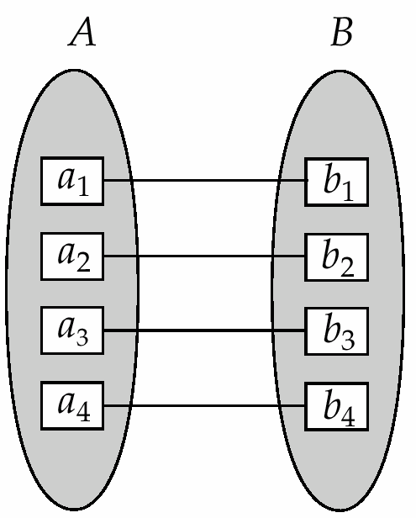
Mapping Cardinalities
One to One (1:1)
An entity in A is associated with at most one entity in B, and an entity in B is associated with at most one entity in A

Slide 29
Mapping Cardinalities
One to One (1:1)
An entity in A is associated with at most one entity in B, and an entity in B is associated with at most one entity in A
A
B
Customer
Borrows
Loan
A customer can borrow 1 loan and vice versa
Some elements in A and B may not be mapped to any elements in the other set

Slide 30
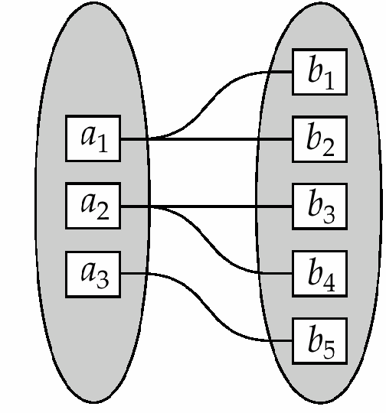
Mapping Cardinalities
One to Many (1:M)
An entity in A is associated with any number (zero or more) of entities in B. An entity in B, however, can be associated with at most one entity in A

Slide 31
Mapping Cardinalities
One to Many (1:M)
An entity in A is associated with any number (zero or more) of entities in B. An entity in B, however, can be associated with at most one entity in A
Customer
Borrows
Loan
A Customer can borrow more than 1 loan, whereas a loan has only one borrower
Customer
Loan

Slide 32
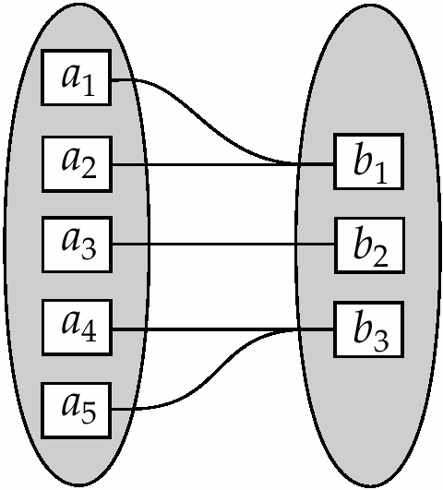
Mapping Cardinalities
Many to One (M:1)
An entity in A is associated with at most one entity in B. An entity in B, however, can be associated with any number (zero or more) of entities in A

Slide 33
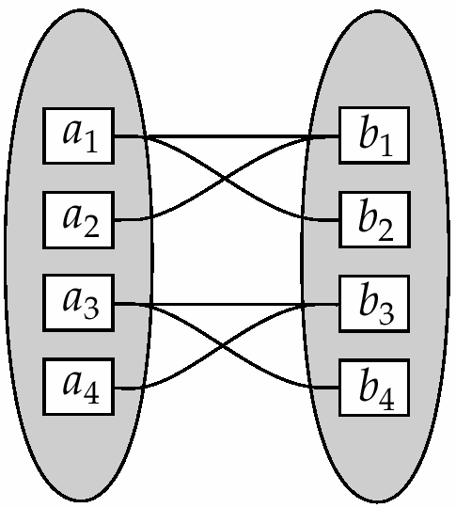
Mapping Cardinalities
Many to Many (M:N)
An entity in A is associated with any number (zero or more) of entities in and an entity in B is associated with any number (zero or more) of entities in A

Slide 34
Mapping Cardinalities
Many to Many (M:N)
An entity in A is associated with any number (zero or more) of entities in and an entity in B is associated with any number (zero or more) of entities in A
Customer
Borrows
Loan
A customer can borrow more than one loan
A loan can have more than one borrower.
Customer
Loan

Slide 35
Participation Constraints
Total Participation
The participation of an entity set E in a relationship set R is said to be total if every entity in E participates in at least one relationship in R
Partial Participation
If only some entities in E participate in relationships in R, the participation of entity set E in relationship R is said to be partial

Slide 36
Participation Constraints
Total
Example
Customer
Borrows
Loan
Partial
Every loan must have a customer
Every customer (of the bank) does not borrow a loan

Slide 37
References
Chapter 2, Database System Concepts, Silberschatz, Korth, Sudarshan

